Slide 1
Website Optimization beyond Lighthouse
kuch cheezein dikh’ti nahi hain… par hoti zarur hain.
Notes:
Hook: Start with '3 seconds. That's all you have.' Make eye contact, pause for dramatic effect. Frame this as an opportunity, not a problem.

Slide 2
3
That's All You Have
53% of users abandon if load > 3 seconds
5.47 MB initial bundle
Performance Score: 45/100
Just like how Abhijeet wants the output form us after assigning a task.
Notes:
Don't shame the current state. Frame as 'opportunity for improvement'. Use hand gestures to emphasize the 3-second countdown.

Slide 3


What is a lighthouse ?
Just a tool to measure a performance of the website.
How to access it :-
1. on Developer tools
2. chrome extensions
3. Through terminal

Slide 4
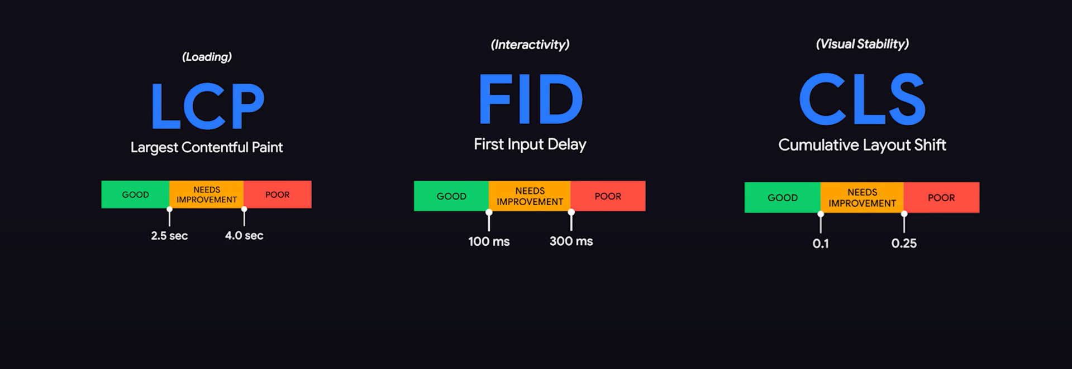

Core web vitals
Notes:
Use hand gestures to show timeline progression. Emphasize that Lighthouse measures user experience, not just speed.

Slide 5
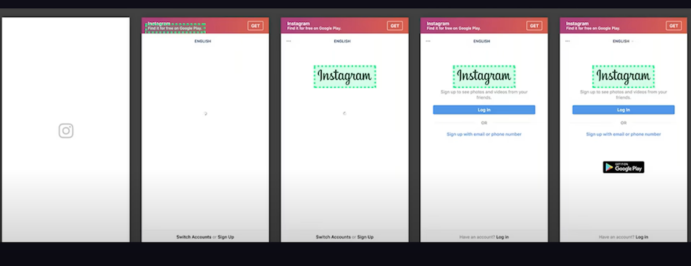
LCP :- Time taken for the largest visible element (like hero image, banner, or main text) to fully appear on the screen.

Slide 6

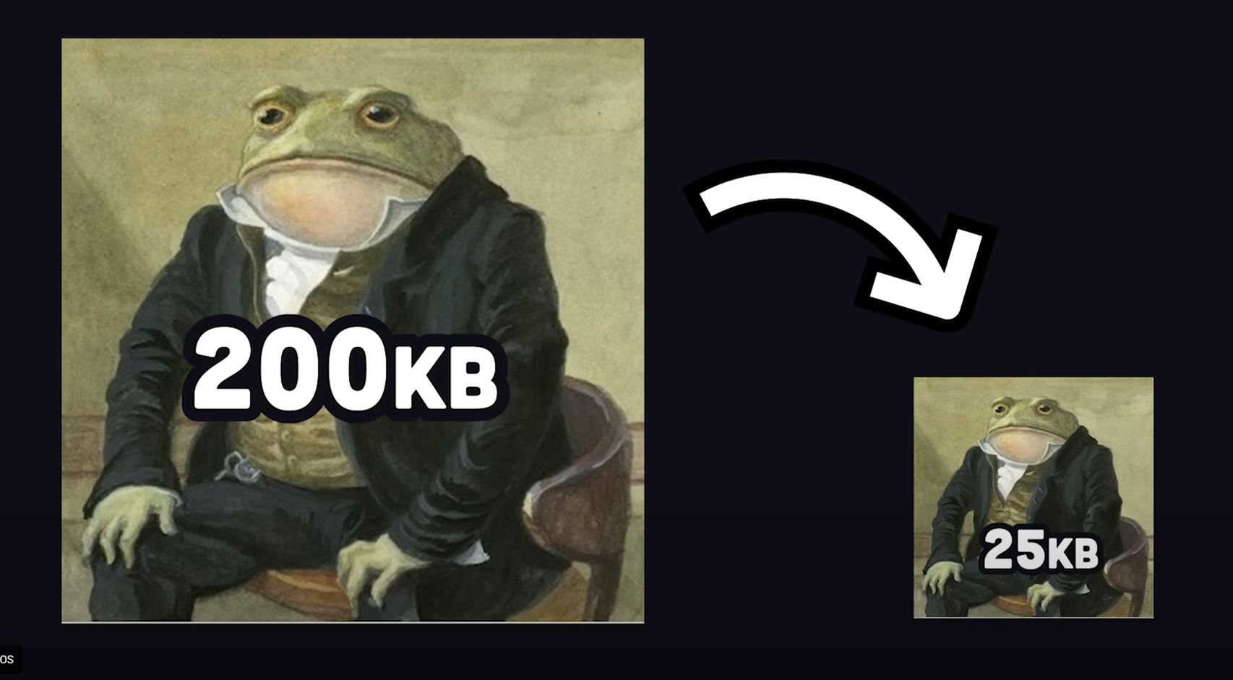
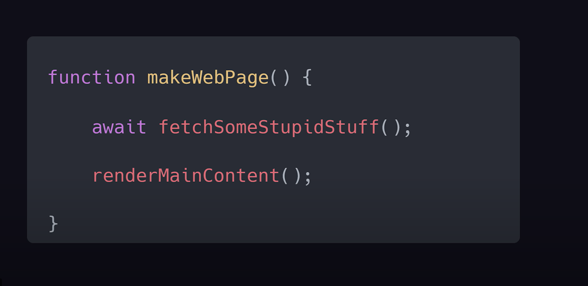
Optimizations
Reduce resource load time
USE CDN
Blocking JS
Preloading

Slide 7


FID :- Interactivity Time between a user’s first interaction (like click/tap) and when the browser responds.
Reduce heavy JavaScript.
Split long tasks.
Use lazy loading.

Slide 8
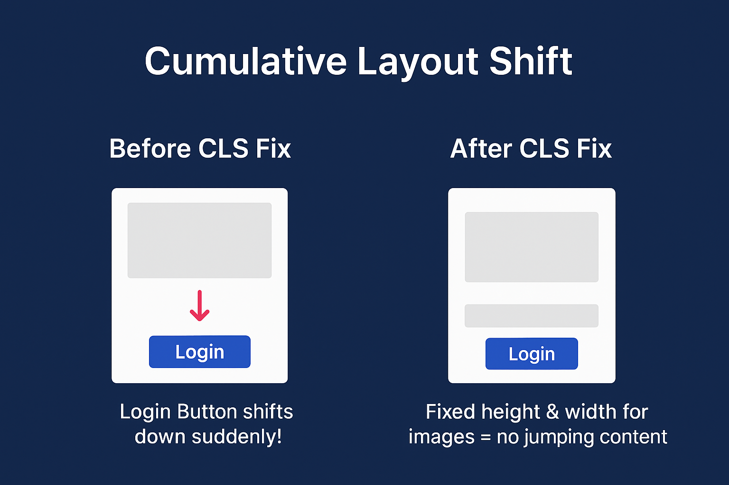
Measures how much visible content shifts unexpectedly during page load.
Set width/height for images & ads.
Avoid injecting content above existing elements.
Use CSS transform for animations instead of top/left.

Slide 9
Changes I did on my Angular Project.

Slide 10
OnPush: Smarter Change Detection
The Problem: Every HTTP request triggers change detection across the entire component tree
@Component({ selector: 'app-dashboard', templateUrl: './dashboard.component.html', changeDetection: ChangeDetectionStrategy.OnPush })
Impact: 40-60% reduction in change detection cycles • TTI improvement: ~1-2 seconds
Notes:
'Not every component needs this—start with leaf components.' Show the dramatic reduction in CPU usage.

Slide 11
Async Font Loading: Don't Block the Critical Path
Current Problem: These block rendering!
<link href="https://fonts.googleapis.com/css2?family=Roboto:wght@300;400;500&display=swap" rel="stylesheet">
Optimized Approach: Preconnect + Async Load
<!-- Preconnect to speed up DNS/TCP/TLS --> <link rel="preconnect" href="https://fonts.googleapis.com"> <link rel="preconnect" href="https://fonts.gstatic.com" crossorigin> <!-- Async load with font-display: swap --> <link href="https://fonts.googleapis.com/css2?family=Roboto:wght@300;400;500&display=swap" rel="stylesheet" media="print" onload="this.media='all'">
Impact: FCP improvement of 400-800ms • Better perceived performance
Notes:
Show the dramatic difference between blocking and non-blocking font loading. Emphasize the FCP improvement.

Slide 12
Watch the Magic Happen
1. Here's the current dashboard—watch the metrics
2. I'll apply OnPush to just 3 components
3. Rebuild and re-run Lighthouse
Notes:
Have a backup video in case of technical difficulties. Show the dramatic improvement in real-time.

Slide 13
Thank You for Your Time
Let's make the web faster, one optimization at a time.
Notes:
End on a positive note. Encourage follow-up conversations. Thank the audience for their attention.

